Slide 1
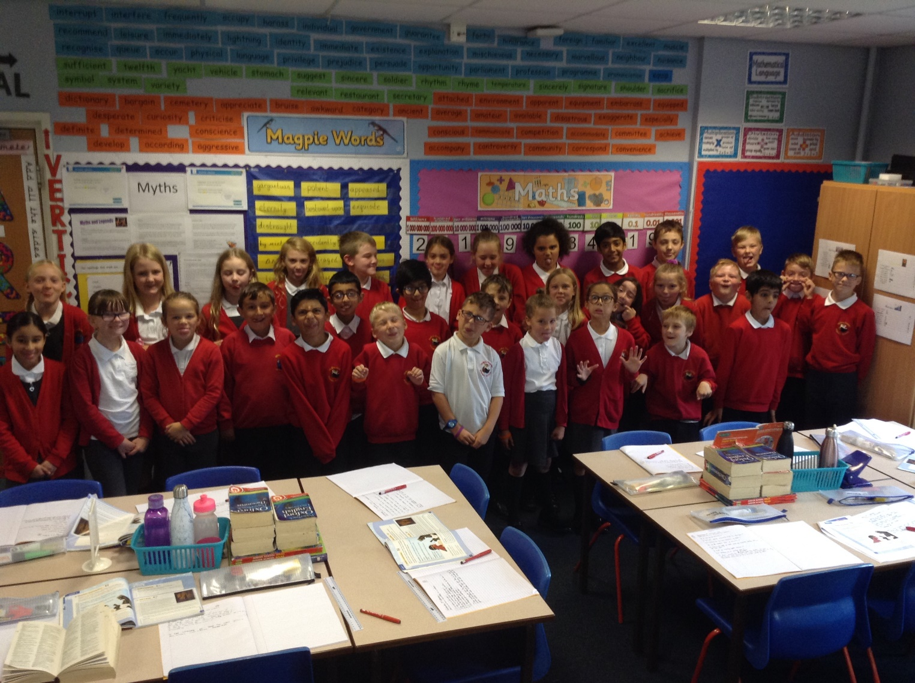
Welcome to Year 5

Slide 2
PE kit is needed for Tuesday and Wednesday. Our current unit is dance.
Children are responsible for changing their book when finished. Me and Mrs Hughes listen to children reading during Guided Reading sessions and during reading activities in English
PPA
The lane
Term-time holidays will only be authorised in exceptional circumstances.
General Information

Slide 3
General Information
Spellings will be taken home on a Friday and tested the following Friday. The focus this term will be the Year 5 / 6 National Curriculum spelling patterns and the spellings list (please pick up a list from the front).
Mrs Rhodes
Pencil cases
Water bottles
Names in clothes and PE kit.
Attendance, 90% is classed as persistent non attendance, this works out at 3 days per half term. If illness is affecting attendance we will contact the school nurse for advice.

Slide 4
Homework
Weekly homework is linked to numeracy and literacy work in class and targets. This will be given out on Thursdays.
We have a homework trophy in school for the class who completes the most homework each week.
Homework must be returned by Wednesday as this is when it will be marked.
We do have a homework club in school for children.
Maths homework will be completed using SUMDOG.
New spellings will be given on Friday.
Grid homework

Slide 5
Literacy
This term units will include:
Myths – Prometheus and Pandora.
Instructions
Narrative Poetry
Information text – Monsters!
The modern retelling of Myths.
Recounts

Slide 6
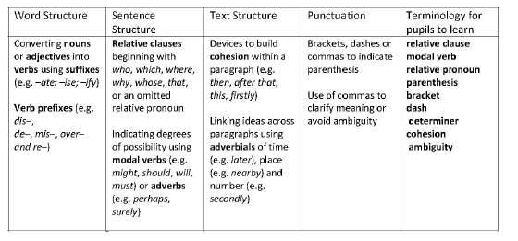
Grammar
Underline the modal verb in each sentence below. The first one is done for you.
We might see the famous singer.
They must finish the race.
I should help Mum.

Slide 7
Numeracy
Units this term will include:
Place Value of number (up to 1,000,000)
Addition using jottings, number lines (for difference) and column addition.
Subtraction
Fractions
Measure converting between metric and imperial
Multiplication
Geometry (finding missing angles)
Maths groups
Weekly Arithmetic test – results will be kept and provided for you to see at parents evenings. These are always private scores.

Slide 8
Numeracy
Example questions for Year 5;
$\frac{6}{7}$ x 4 =
$\frac{3}{7}$ + $\frac{9}{14}=$
3ᵌ x 9² =
Calculate the size of angle x and angle y.
Do not use a protractor

Slide 9
Our learning challenges for this half term are:
KS2 Geography: locate the world’s countries, using maps, to focus on South America and concentrating on their key physical and human characteristics, countries, and major cities.
WOW: Show a special video about Brazil which captures the main aspects of the country
LC1 | What do you already know about Brazil?
LC2 | What fruits and other natural resources is Brazil famous for?
LC3 | Which famous cities in Brazil attract tourists and why?
LC4 | What can you find out about one of Brazil’s neighbouring countries?
LC5 | Can you design and create a collage of Brazilian symbols?
LC6 | Why is Brazil famous for its dancing?
LC7 | What can you find out about the street children of Brazil?
LC8 | What can you find out about a famous Brazilian?
Other topics this year include;
Anglo-Saxon Britain.
Ancient Egypt.
Will you look the same as your grandparents?
Crime Scene Investigating.

Slide 10
Rewards and consequences
Children have developed rules which fit with school rules.
Good work, behaviour, effort, homework etc will lead to them receiving house points, opportunities to show work in Good Work assembly, SMILE awards, being an always ticket winner.
If children do not stick to the class and school rules they receive a warning, if it continues they move their names to yellow, further rule breaking will result in loosing an always ticket. Losing three Always tickets will result in a letter home.
Children who misbehave at lunch may be sent to the reflection room at lunch time. Three visits to the reflection room a half term will result in a letter home.

Slide 11
Expectations and end
of year Targets
Children will be constantly assessed currently using Year 5 expectation statements which is standard across the country. This enables us to give track progress and plan next steps. Secure, within and beginning.
Year 5 will complete assessments this year.
This data currently will be reported to children and parents.
School uses these results and other ongoing teacher assessment to make judgements about children’s attainment and progress.

Slide 12
Uniform
All this information for uniforms is available on the school website.
http://www.hollinsgrundy.com/parents-carers/admission-arrangements/attendance/uniform-and-jewellery/

Slide 13
Class Page
http://www.hollinsgrundy.com/classes/year-5/

Slide 14
Extra notices
Parents evening will be on October 9th and 10th with a 3:00pm start both days and a 5:30 finish.
Open Day 6th November
OWLS after school club
Please take your letters
Spellings
School arrivals
Walking Bus
Trips
20th November; Anglo Saxon Day. £9.50
Jodrell Bank, Tuesday 10th March (leaving school at 8:45am).

Slide 15
Questions?

