Slide 1
Read Write Inc. Phonics
Parents’ Meeting

Slide 2
Teach a child to read
and keep that child reading [and talking]
and we will change everything.
And I mean everything.
Jeanette Winterson

Slide 3
Dinosaur names
Brachiosaurus
Baryonyx
Compsognathus
Iguanadon
Ornithomimus
Oviraptor
Notes:
Invite the parents to read the names out loud.
Ask the parents how it made them feel?
Tell the parents, that’s how your children will feel when they are being asked to read simple words like “cat”
Also highlight that they would have started to break down the words into smaller segments and blending them together, so when they come across a word they don’t know they use Phonics to help them.

Slide 4
Who is Read Write Inc. Phonics for?

Slide 5
Read Write Inc. Phonics
Nursery – Y1 (KS1)
Older children who need to‘catch-up’
Children new to English

Slide 6
What is Read Write Inc. Phonics?

Slide 7



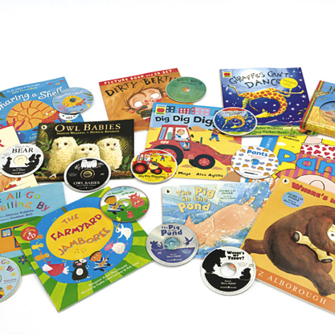




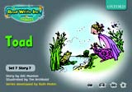
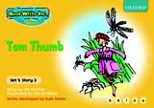
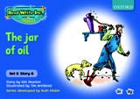
Systematic approach
sat
mat
p
d
sad
i
t
n
Notes:
First we teach the children the sounds, then we blend them together to read words and finally the children are able to read sentences in books.

Slide 8
What is systematic phonics?

Slide 9
Phonics
Sounds
Graphemes
Notes:
Sounds are what we hear, graphemes are how we write the sound.

Slide 10
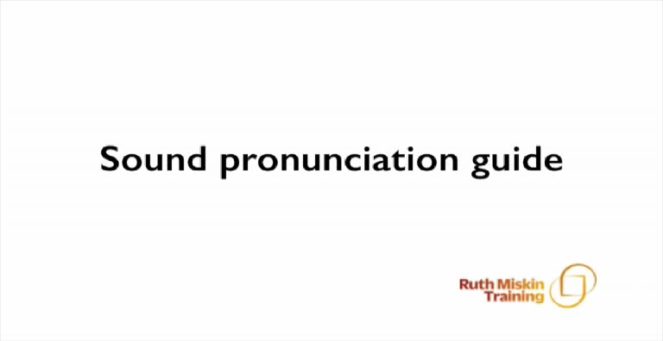
Pure Sounds
https://ruthmiskin.com/en/find-out-more/parents/#lg=1&slide=2
Notes:
Check this link
Highlight to the parents schwaring, putting the uh sound on the end of a sound, eg c-uh not c

Slide 11
English alphabetic code
44 sounds
Over 150+ graphemes
One of the most complex alphabetic codes in the world.
Spanish
24 speech sounds
26 letters to make up those sounds
29 graphemes
English
44 speech sounds
26 letters to make up those sounds
150 graphemes
Notes:
There are more than 150 graphemes for example there are 9 different ways to write “or”
Children learning to read in English have a much more difficult and complex code to learn than children reading in other countries.

Slide 12
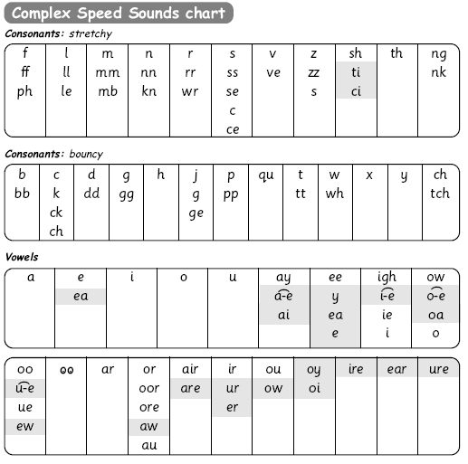
Speed Sounds chart

Slide 13
How does Read Write Inc. use phonics to teach reading?

Slide 14
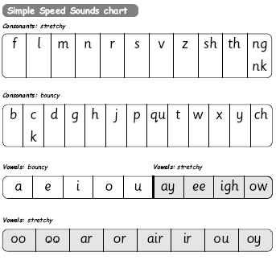
Simple Speed Sounds
Notes:
Phonics makes learning to read easy for children because we start by teaching them just one way of reading and writing every sound. Here they are on the Simple Speed Sounds chart.
We teach Set 1 sounds first - (sounds as far as a e i o u) and then Set 2 (the shaded sounds ay - oy).
Children tend to learn all of these sounds by the end of Reception class.

Slide 15
Blending using Fred Talk
p
sat
d
mat
i
t
sad
n

Slide 16
Complex Speed Sounds chart
Notes:
This will begin in Year 1 and continue throughout the school.

Slide 17
Storybooks
Notes:
Highlight that the children will only read the books when they are secure in the sound level.

Slide 18
How does Read Write Inc. teach spelling?

Slide 19

Fred Fingers
Notes:
Demonstrate spelling using Fred fingers. Ensure the use of pure sounds with the parents.

Slide 20
What should my child read at home?

Slide 21
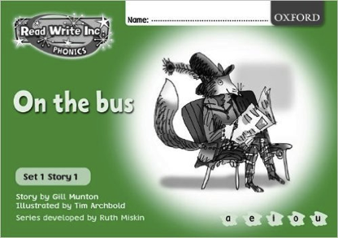
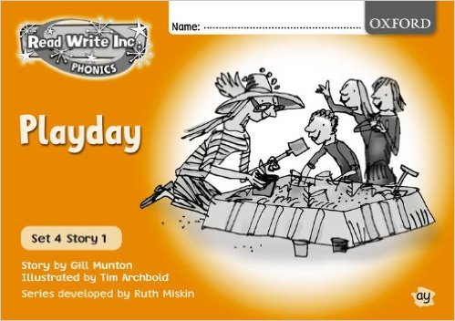
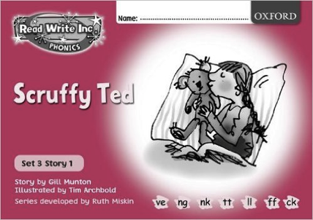
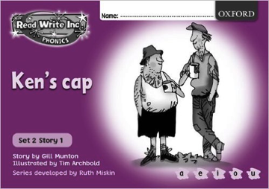
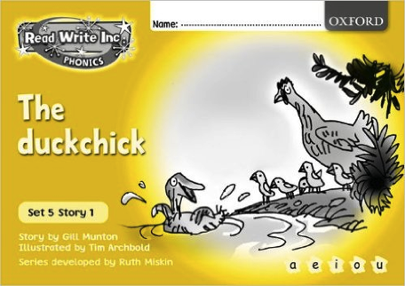
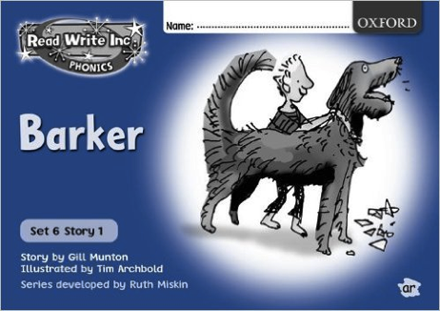
Read Write Inc. Storybooks
Notes:
Children will begin by reading RWI books as home readers but then they will a range of books to help them develop other reading skills.

Slide 22
How can I help at home?

Slide 23
Storytime
Read to your children
Ask lots of questions and share opinions
You're never too old, too wacky, too wild, to pick up a book and read to a child.
Dr Seuss

Slide 24
Talking
Talk to your child as much as possible and ‘feed’ them new and ambitious vocabulary.
“Let’s eat our lunch now.”
“Let’s munch our lunch now.”
“Let’s scoff our lunch now.”
“Let’s devour our lunch now!”
You’re looking ... not just... but...

Slide 25
Vocabulary
Enrich conversations through description:
“Look at that rain. It looks like little diamonds sparkling on the window pane!”
Have fun with words and language.
“I’m as hot as a spud in a cooking pot!”
Praise your child for using new words or interesting phrases

Slide 26
Online resources available
Ruth Miskin Parents’ Page:
https://ruthmiskin.com/en/find-out-more/parents/
Ruth Miskin Facebook:
https://www.facebook.com/miskin.education
Free e-books for home reading:
http://www.oxfordowl.co.uk/Reading/
Notes:
Check these links

Slide 27

Any other questions

Slide 28
Reading feeds the imagination, it expands
horizons and offers new and exciting ways of
seeing and making sense of our lives and of
the world around us.
Michael Morpurgo

