Slide 1
Parents’ Meeting
Introduction to Read Write Inc.
Notes:
Approximately 20 minutes is needed for this session.
Notes are provided to help you lead the presentation.
Notes in italics are for your attention only.
This bitesize parent session is designed as an introduction to Read Write Inc when you first implement the programme in your school and for parents of new YR children each September.
Use the other bitesize parent PPTs throughout the year to discuss and practise how they can help their child at home based on the child’s group.
Notes are provided to help you lead the presentation.
Notes in italics are for your attention only.
Provide copies of ‘Reading at Home Booklet 1 or 2’ from Oxford Owl.
Booklet 1 is sound groups and Ditty/ Red Groups and Booklet 2 for Green – Grey Storybooks.

Slide 2
Reading changes everything
Teach a child to read and keep that child reading and we will change everything.
And I mean everything.
Jeanette Winterson
Notes:
Read quote.
This is what we do in our school.
Research shows that children who learn to read quickly go on to succeed in school and in life.
Today I want to help you understand how your child is learning to read with phonics – specifically ‘Read Write Inc.’ Phonics.

Slide 3
Read Write Inc. Phonics and Fresh Start
Children learning to read in YR– Y2
Older children who need to ‘catch up’
Fresh Start – Year 5 and Year 6
Taught in groups based on their stage of reading
Notes:
Who Is Read Write Inc Phonics for?
(Click) Phonics is for children in Reception, Y1 and Y2 who are learning to read.
Phonics is also for children in Y3 and Y4 who haven’t met the KS1 reading expectations. They need to catch up.
(Click) Fresh Start is for children in Y5 and Y6 who are still learning to read.
Fresh Start is structured in the same way as the Phonics programme, but uses age-appropriate texts.
Each half-term, we assess and group our children based on their stage of reading not age of reading. This means all children practise reading at the right level.
Explain how you group across YR/ across KS1, across Y3/4 as applicable to your school.

Slide 4
English alphabetic code
44 sounds
26 letters
Over 150+ graphemes (letter combinations)
One of the most complex alphabetic codes in the world.
Notes:
We use 44 sounds to make all the words in the English language.
This means we’ve got a problem.
We’ve got 44 sounds and only 26 letters.
The 26 letters work singly, in pairs and sometimes in threes to represent one sound.
We have to group letters together to write some sounds e.g. ‘igh’, ‘air’.
In English we have more than 150 ways to represent 44 sounds, using the 26 letters in the alphabet.
Click
This makes our language one of the most complex in the world!

Slide 5
Speed Sounds Set 1 and Set 2
Notes:
Using RWI, we make learning to read easy for children because we start by teaching them just one way of reading and writing every sound. Here they are on the Simple Speed Sounds chart we use in class.
We teach Set 1 sounds first - (sounds as far as a e i o u).
Children need to know sounds – not letter names – to read words.

Slide 6
Speed Sounds Set 3
Notes:
Once children know one way of reading and writing every sound, they start to learn spellings for each sound they already know.
Point to the chart to show.
For example, they know ‘ay’ and now learn a-e and ai as other spellings for the same sound.

Slide 7
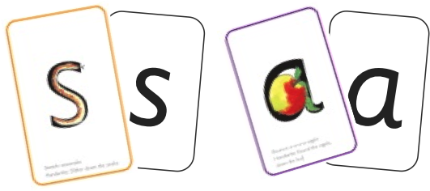

Sounds + blending = reading
+
Notes:
Alongside teaching children sounds, we teach them to blend sounds to read words e.g. s-a-t, sat.
We use Fred Talk to help children read.

Slide 8
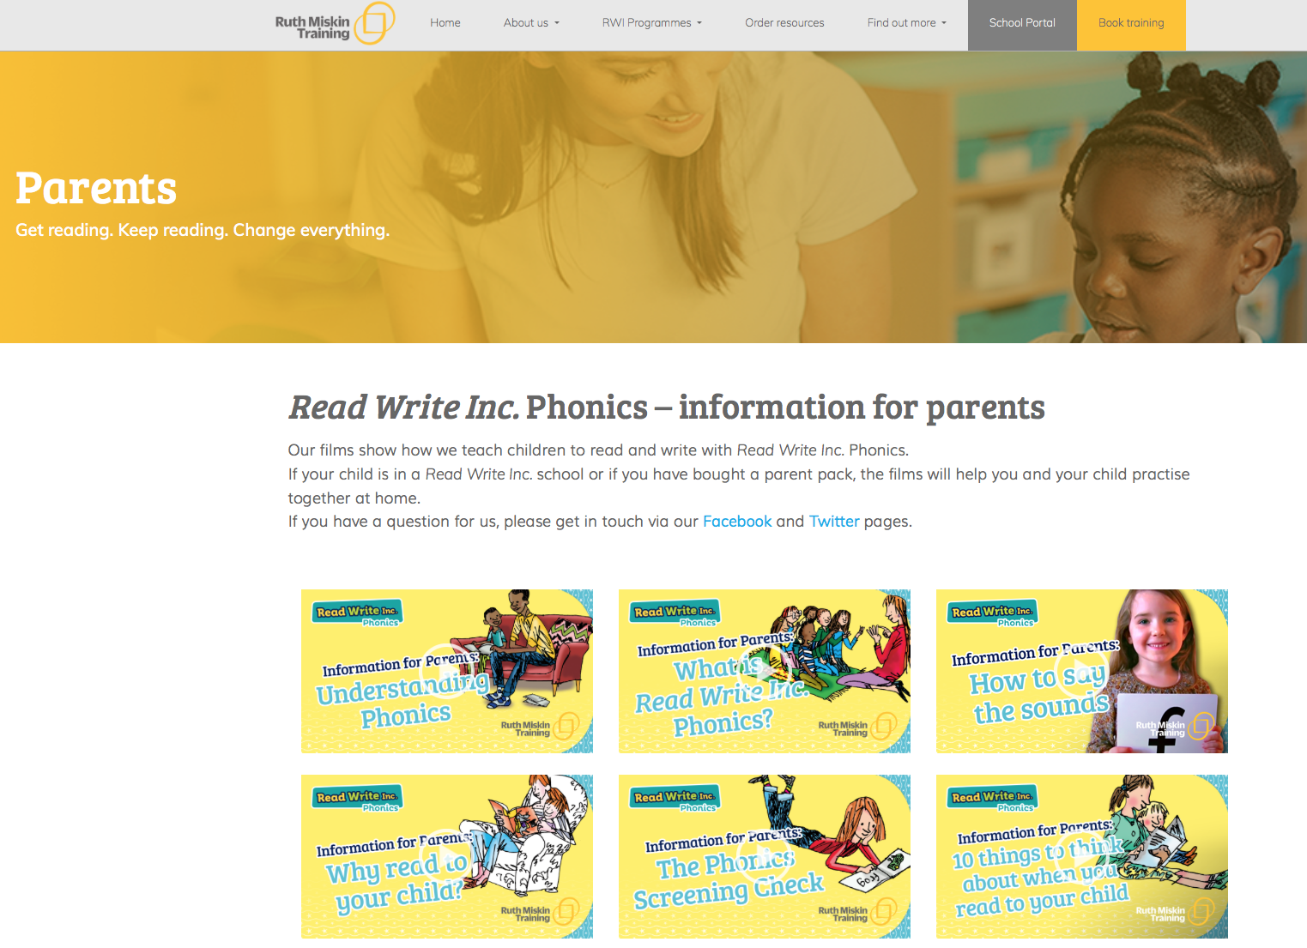
Free Video Tutorials (ruthmiskin.com)
Notes:
Watch video tutorials on the Ruth Miskin website to help you to understand more about Phonics, Read Write Inc. and how to practise reading and writing with your child at home.

Slide 9
What can I do?
Use pure sounds, not letter names
Use Fred Talk to read and spell words
Listen to your child read their Storybook every day
Read stories to your child every day
Notes:
We will run regular bitesize meetings to look at each of these in more detail.
Provide copies of ‘Reading at Home Booklet 1 or 2’ from Oxford Owl.
Booklet 1 is sound groups and Ditty/ Red Groups and Booklet 2 for Green – Grey Storybooks.

Slide 10
Online resources available
Ruth Miskin Parents’ Page:
http://www.ruthmiskin.com/en/parents/
Ruth Miskin Facebook:
https://www.facebook.com/miskin.education
Free e-books for home reading:
http://www.oxfordowl.co.uk/Reading/

Slide 11
Reading feeds the imagination, it expands
horizons and offers new and exciting ways of
seeing and making sense of our lives and of
the world around us.
Michael Morpurgo
Notes:
Remember that all parents have the power to change outcomes for their children.

