Slide 1
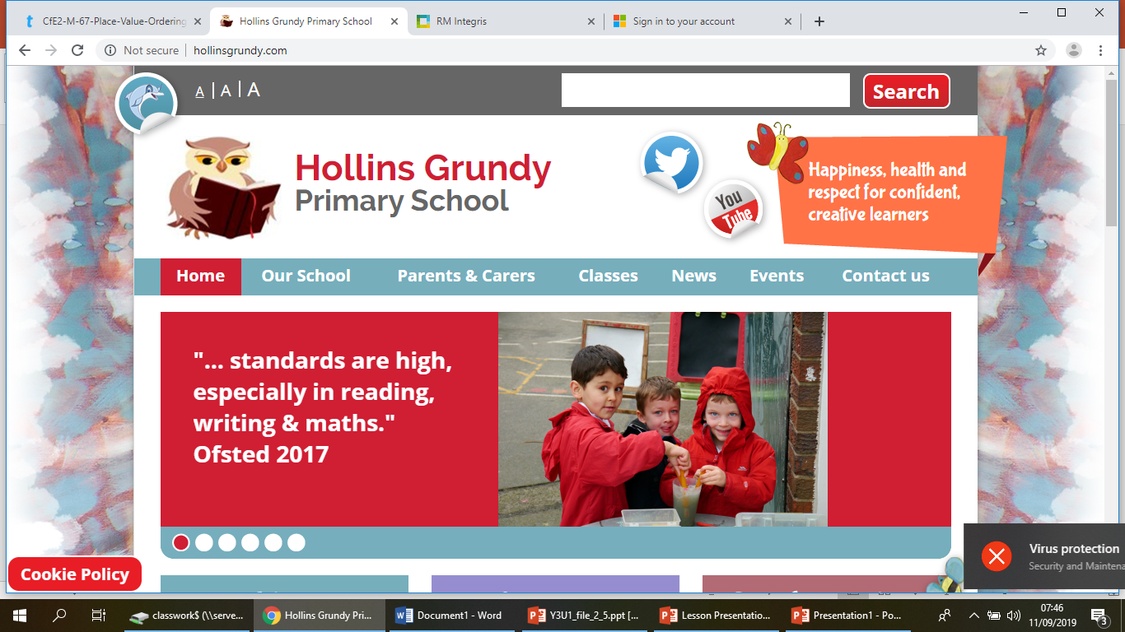
Welcome to Year 3
2024-25

Slide 2
General
Class email – year3@hollinsgrundy.com
I will reply as soon as I can, but this may not be possible on the same day. Please be patient and for anything urgent, please contact the school office.
Please let the office (or myself at the gate) know if your child is to be collected by another parent, family member etc.
Please make sure your contact details are up to date and correct (this can be checked at the school office)
Accident notifications are still electronic.

Slide 3
General
Big leap from Year 2 to 3.
Break time – Half past 10. Free fruit is not provided for Key Stage 2; please send in fruit if you wish your child to have a snack at break time. Fruit only – no cereal bars.
Lunchtime begins at 12.30 for Key Stage 2.
Reading books – children are able to change their own reading books as and when they need. Books are still recorded in school and children still have their home-school reading record.
Homework – Termly grids. Weekly spellings – please see the termly overview but these will be printed and sent home weekly for practice.

Slide 4
Attendance/Punctuality
Good attendance and punctuality is essential to succeed this year.
Persistent non attendance threshold is 90% - If your child’s attendance reaches this, the Local Authority is automatically informed.
If illness is affecting attendance, the school will contact the school nurse for advice.
Holidays during term times are generally unauthorised and will occur a fine. Holidays will only be authorised during term time under exceptional circumstances. (Requests must be made in writing to Mr Waddington).

Slide 5
Rewards/Behaviour
Green, Amber, Red
Verbal
Move name to amber
Move name to red. Moving name to red results in loss of one ‘Always ticket’. If this occurs 3 times in one term, you will be notified.
Sent to Mr Waddington’s office.
Green, Amber, Red is a classroom tool. We will speak to you if we feel it is necessary but it gives children the opportunity to reflect upon behaviour.
Rewards
Housepoints
My Happy Mind
Whole class tokens – whole class reward when we reach 100

Slide 6

No gadgets
No gadgets in school please; phones, tablets, smartwatches etc.
Any personal device that can access the internet or/and cannot be monitored by school potentially puts children at risk that is out of the school’s control.
Any items brought into school will be safely stored by school staff and returned at the end of the day.

Slide 7
Medicines
We only allow medicines prescribed by a GP with prescription attached to the medication. If your child requires medication, you must complete a medical form at the office which details dosage instructions. Medicine and medicine forms must be handed into the office.
We do not allow un-prescribed medication in the building (including cough sweets, strepsils, lip balm etc) We are unable to give a child medicine without a completed medical form.

Slide 8
Illness
If your child is not well enough to attend school, please contact us yourself to let us know as soon as possible.
We kindly ask that you please do not send in messages via other children.

Slide 9
Assessments
We have in-class, formal tests at the end of Autumn and end of year to determine the children’s progress. These are usually held in the penultimate week of each term. These are simply to gauge children’s progress in English and Maths.
We have weekly informal spelling test (Fridays). The Year 3 spellings can be found n the class page.
We have a formal spelling test at the end of each term (Year 3-4 National Curriculum spelling words – please feel free to take a copy).

Slide 10
Swimming
As part of our Year 3 curriculum, we begin Swimming lessons in Spring term (February).
This will usually happen on a Tuesday* – Swimming kits should be sent into school on these dates (appropriate swimwear, towel, goggles). This will count towards our PE slots for that week – come into school wearing PE kits. Should we not be able to swim that day, we will do a regular PE session in place of.
Children will travel to the centre via coach. We will try to return to school for 3:30 but there may be times that we will be delayed due to traffic.
*Please note that the proposed dates are decided by the Leisure centre delivering the lessons and may be subject to change (although unlikely). We will notify you should this occur.

